Slide 1

25MT1306E - Mathematics for Data Science and Analytics
Project Presentation
on
Vehicle Price Analysis
Using Mathematical and Statistical Methods
Under the Guidance of
Dr. M P Mallesh
(Course Faculty)
Mr. M. Nagesh
(Project Guide)
Department of Mathematics
Submitted By
Mokshith M 2510030184
Aneesha M 2510030375
T Ashish Reddy 2510080030
Department of Mathematics | K L Deemed to be University | June 2026
Notes:
Introduce the title, subject, team members, course faculty and guide. Keep this slide under 20 seconds.

Slide 2
Problem Statement & Objectives
02 / 08
Why used vehicle pricing needs a data-driven approach
The Pricing Problem
M1–M6
0.804
Used vehicle prices depend on age, usage, fuel type, transmission, ownership, engine power, brand and model. Manual estimation is often inconsistent because these factors interact with each other.
Complete Workflow
Best R² Score
Cleaning → Dashboard
Final Model
6,926
8
Cleaned Records
Models Compared
After duplicate removal
Feature combinations
Project Objective
Analyze the used vehicle dataset and build a regression model capable of predicting resale value with reasonable accuracy.
Pitch in one line
Transform raw vehicle listings into meaningful price insights and a predictive model.
Vehicle Price Analysis | Mathematics for Data Science and Analytics
2
Notes:
Explain why vehicle price prediction is hard and state the main objective. Mention that the complete pipeline follows M1 to M6.

Slide 3
Dataset & Methodology
03 / 08
CarDekho used vehicle dataset processed through a complete analytical pipeline
6,926
13
Final Records
Core Columns
Dataset
Cleaning
EDA
Probability
Inference
Regression
Dashboard
Cleaned dataset
Before encoding
1,383
Selling Price
Methodology Summary
Final Features
Target Variable
The project follows an end-to-end mathematical and statistical workflow: data cleaning, exploratory analysis, probability analysis, statistical inference, regression modeling and final dashboard interpretation.
After encoding
Resale value
Major Inputs
Year • Kilometers Driven • Mileage • Engine • Max Power • Fuel • Transmission • Owner • Brand • Vehicle Model
Goal: Explain + Predict Used Vehicle Prices
Vehicle Price Analysis | Mathematics for Data Science and Analytics
3
Notes:
Summarize dataset size, target variable and the workflow. Keep this slide visual and brief.

Slide 4
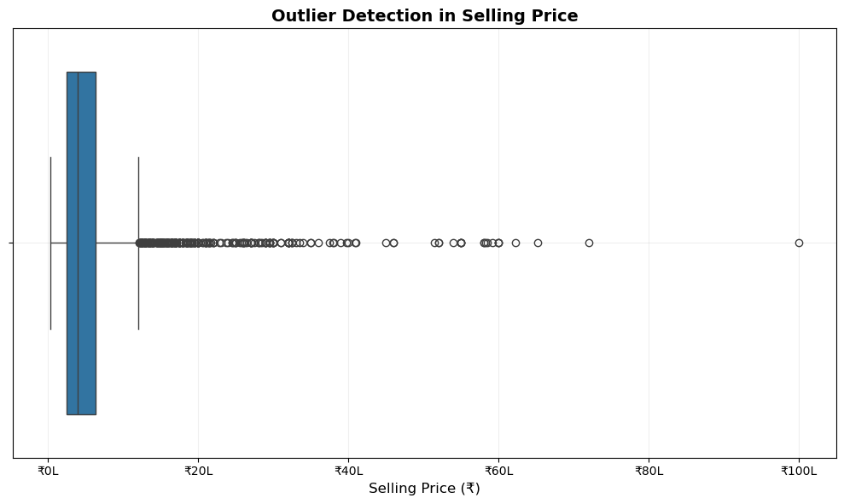
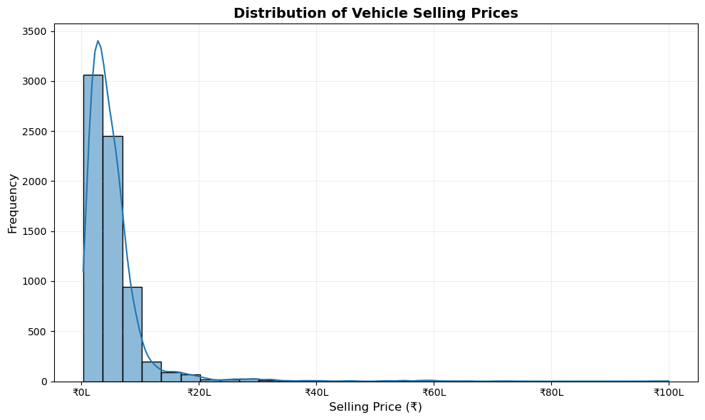
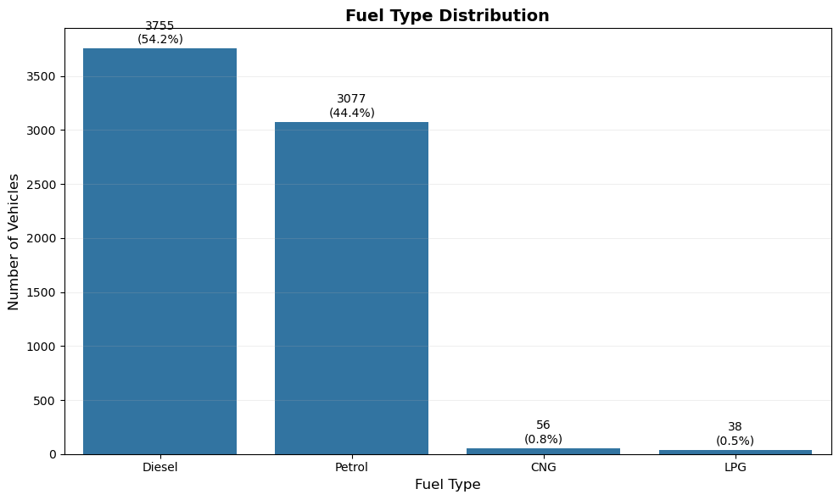
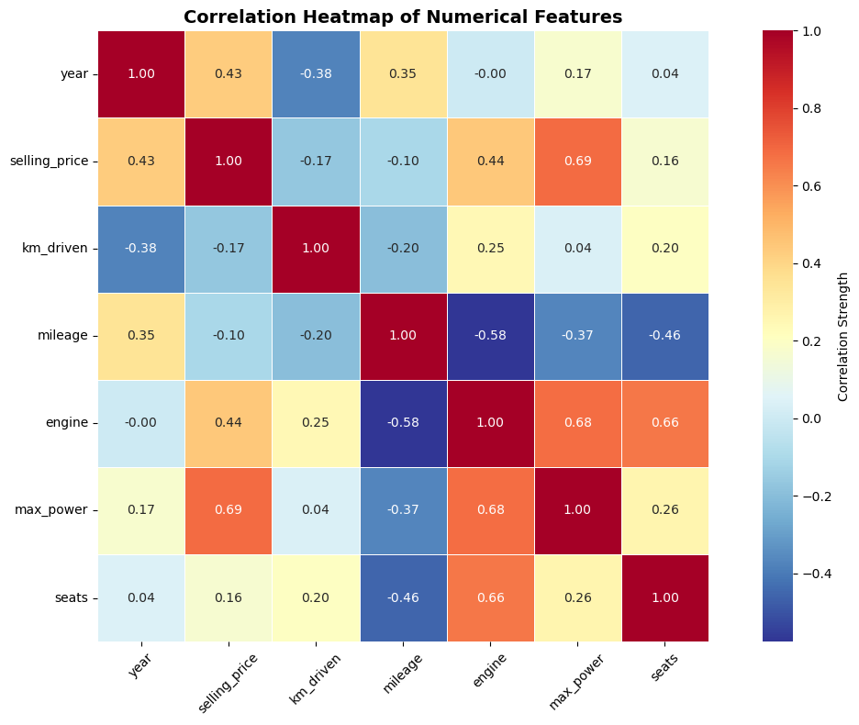
M1 & M2: Cleaning + Exploratory Analysis
04 / 08
From raw data to interpretable patterns
M1 Cleaning
• Median / mode imputation
• 1,202 duplicates removed
• Numeric conversion
• Outliers analyzed
Outlier Detection
Selling Price Distribution
Key Insights
• Price is positively skewed
• Diesel & Petrol dominate
• Manual vehicles are most common
• max_power has strongest positive correlation with price
Fuel Type Distribution
Correlation Heatmap
Vehicle Price Analysis | Mathematics for Data Science and Analytics
4
Notes:
Explain that M1 prepared clean data and M2 revealed skewness, category dominance and max_power correlation.

Slide 5
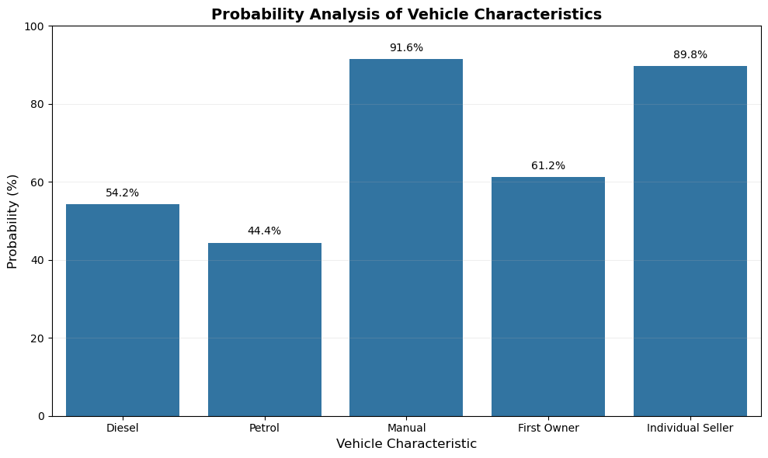
M3 & M4: Probability + Statistical Inference
05 / 08
Quantifying dataset composition and validating price conclusions
54.22%
91.57%
Diesel Vehicles
Manual Transmission
61.25%
89.78%
First Owner
Individual Seller
Probability Analysis of Vehicle Characteristics
Statistical Inference Result
Mean Price
95% CI
t-value
p-value
₹5.17 Lakh
₹5.05–₹5.30 Lakh
2.7653
0.0057
Conclusion: Mean selling price is statistically different from ₹5,00,000 at 5% significance level
Vehicle Price Analysis | Mathematics for Data Science and Analytics
5
Notes:
Mention main probabilities and explain that p-value is below 0.05, so the null hypothesis is rejected.

Slide 6
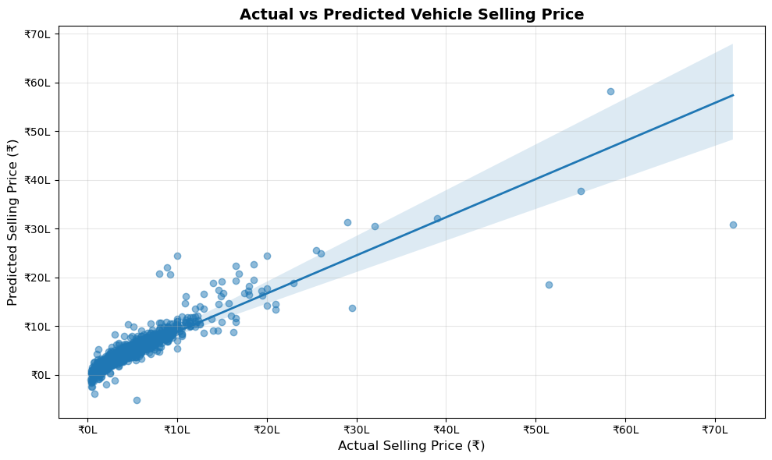
M5: Regression Modeling & Prediction Results
06 / 08
Eight models compared; feature engineering delivered the best result
Best Model
R² = 0.804
≈ 80.4% variation explained
₹87,969
₹2,07,320
MAE
RMSE
Avg absolute error
Large-error sensitive
Actual vs Predicted Selling Price
Why Model 8 Worked
Model Comparison
Brand and detailed vehicle model extracted from the name column captured manufacturer-specific and model-specific pricing patterns.
Numerical-only models gave moderate results. Adding categorical + brand + model features produced the final score.
Vehicle Price Analysis | Mathematics for Data Science and Analytics
6
Notes:
This is the strongest slide. Emphasize that eight models were compared and feature engineering improved R squared to 0.804.

Slide 7
M6: Dashboard & Final Results
07 / 08
Summarizing the project outcome in decision-friendly metrics
6,926
1,383
Model 8
0.804
Cleaned Records
Encoded Features
Best Model
Final R² Score
Business Interpretation
Limitations
What This Proves
The model can estimate used vehicle prices using available specifications and vehicle identity features. It is explainable and practically useful for decision support.
Vehicle condition, accident history, service record, insurance, exact location and negotiation details were not available in the dataset.
Mathematical and statistical methods can turn raw listings into meaningful insights and a strong predictive model.
Final Result: Strong and explainable regression model for used vehicle price estimation
Vehicle Price Analysis | Mathematics for Data Science and Analytics
7
Notes:
Summarize dashboard results, limitations and the practical meaning of the project.

Slide 8
Conclusion & Future Scope
08 / 08
From vehicle data to a complete analytical price-estimation pipeline
Achievements
Future Scope
Final Message
✓ Complete M1–M6 workflow
✓ Data cleaned and analyzed
✓ Probability and inference applied
✓ 8 regression models compared
✓ Final R² = 0.804
• Random Forest Regressor
• Gradient Boosting / XGBoost
• CatBoost
• Web-based price prediction application
Feature engineering and statistical analysis significantly improved prediction quality and made the model more realistic.
Thank You
Vehicle Price Analysis | Team: Mokshith M, Aneesha M, T Ashish Reddy
Vehicle Price Analysis | Mathematics for Data Science and Analytics
8
Notes:
Conclude with achievements, limitations and future work. End confidently and invite questions.

